Slide 1
Chemical and Biological Materials
Unit-Biomaterials
B.Tech Sem I

Slide 2
Syllabus Unit: Biomaterials
Biomaterials:
Types of Biomaterials,
Biocompatibility,
Surface Properties of Biomaterials,
Applications of Metallic Biomaterials,
Biocompatible materials.
Ceramic biomaterials,
bioactive ceramics,
Polymeric Biomaterials.
Diamond like carbon films.

Slide 3
BIOMATERIALS
Definition 1
the unique materials (other than drugs) or combinations of materials that are primarily expected to be used inside a mammal or human to treat, repair, augment or replace any tissue is referred to as biomaterials
Definition 2
any material that comes into contact with humans or animals to fulfil their intended function without causing any toxic reaction.
Definition 3
a material designed to take a form that can direct, through interactions with living systems, the course of any therapeutic or diagnostic procedure.”
This is the single most crucial aspect that differentiates a biomaterial from any other material, i.e., its capacity to be in contact with human body tissues without instigating an undesirable degree of response

Slide 4
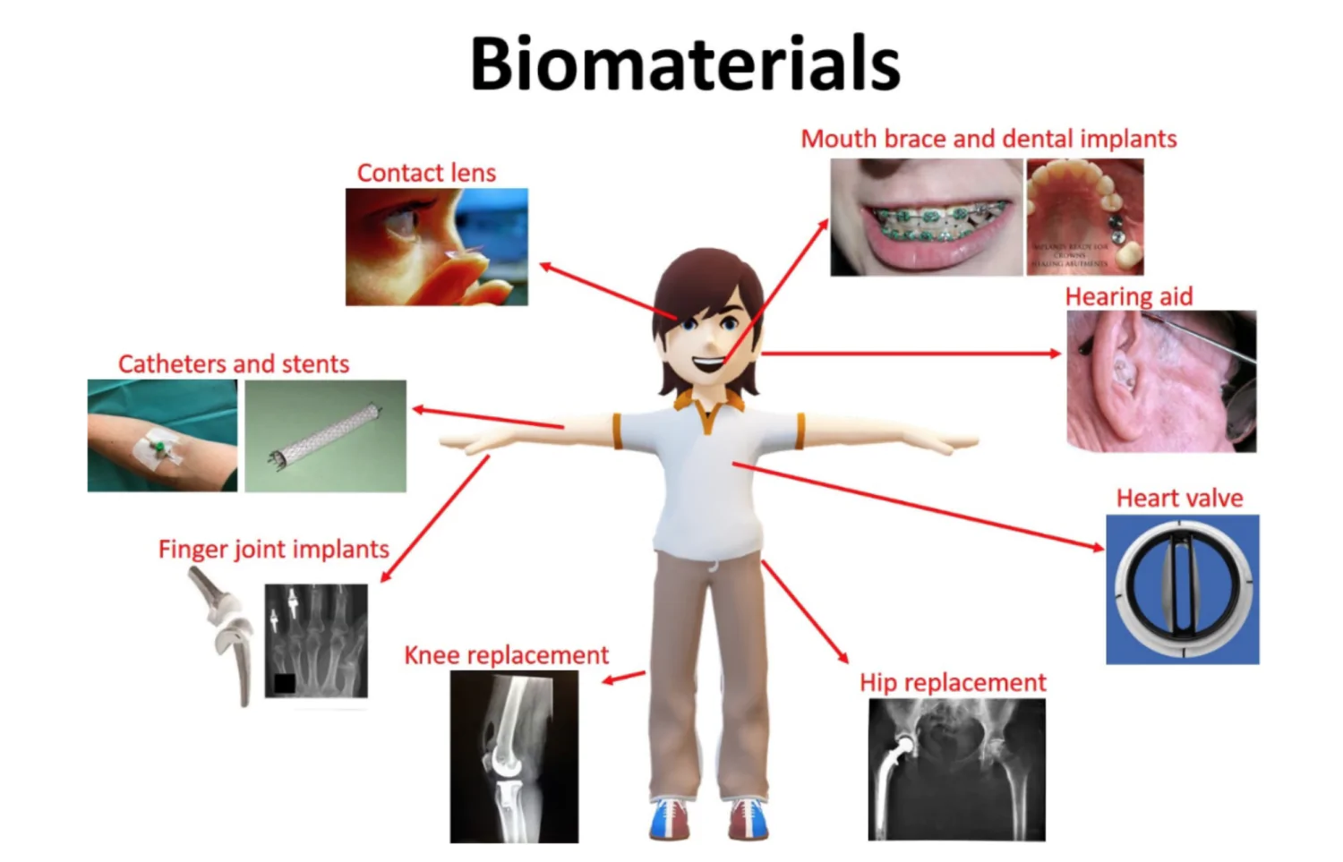
Biomaterials
Biomaterials are substances that can interact with biological systems for medical purposes. Biomaterials can be derived from nature or synthesized in the laboratory using a variety of chemical approaches.
Characteristics of Biomaterials
i) Biocompatible
ii) Nontoxic
iii) Noncarcinogen
iv) Good physical mechanical properties
v) Low cost
vi) It must be readily available
vii) Should be moulded into different shape
viii) Resistant to degradation
ix) Acceptable strength
x) Resistant to wear

Slide 5
NEED OF BIOMATERIALS
Human tissues
Sometimes fail to perform their regular actions that may be due to the genetic defects, age, illness, trauma, degeneration and injuries
Medications
Some of these conditions can be handled through regular medication
If cannot repaired/rectified through medication
Requirement of unique materials and devices arises
Require surgical repairs that involve anatomical sections like knee joints, elbow joints, vertebrae, teeth or even more crucial organs like heart, kidney , skin etc
The number of medical devices used annually by humans
is significant, estimated at 1.5 million by the World Health Organization,
with around 10,000 forms of standardized device classes available
worldwide.

Slide 6
Multidisciplinary Approach
Material Science
It needs the synergistic integration of materials, biology, medicine, mechanical sciences, and chemistry.
Biology
Physics
Mathematics/Geometry
Chemistry

Slide 7
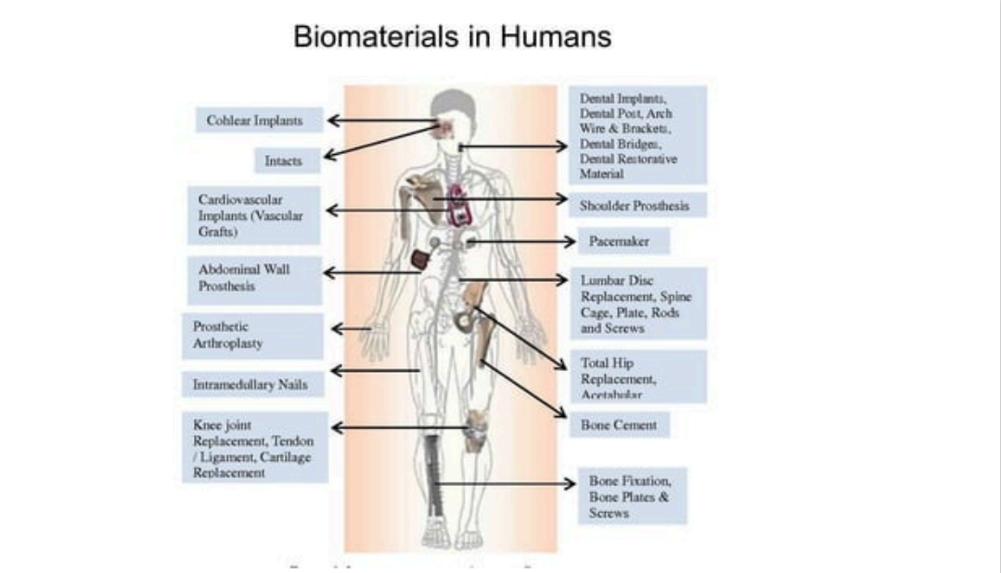

Slide 8
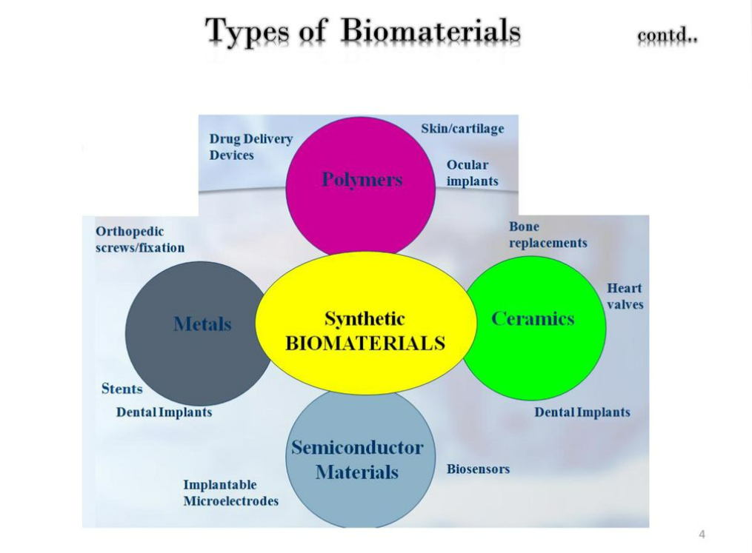
Biomaterials

Slide 9
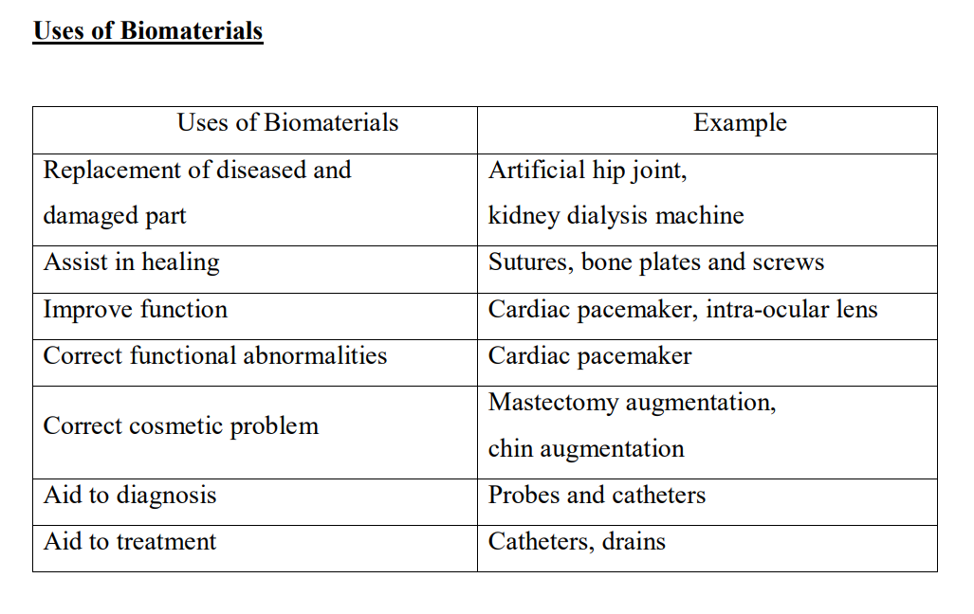
Biomaterials

Slide 10
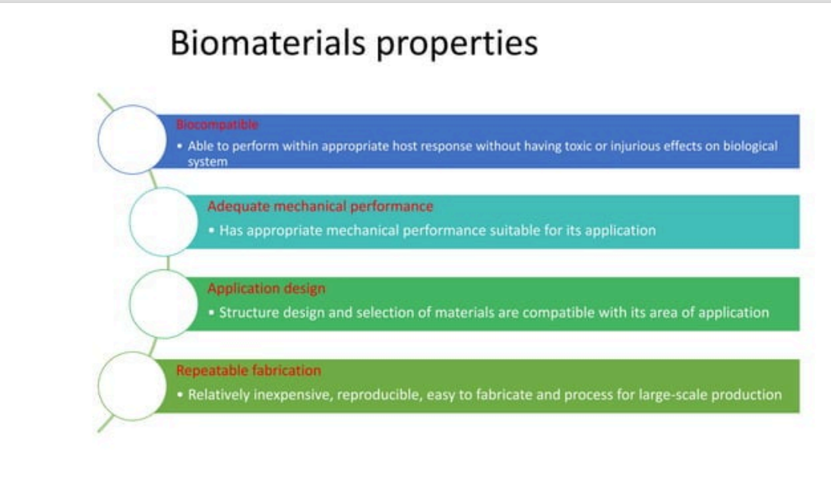

Slide 11
Desired properties of biomaterials
As discussed earlier, the ultimate goal of biomaterials in medicine is to treat, improve, or substitute tissue organs (e.g., bone, muscle, skin) or body function.
Such goals can be accomplished by integrating the properties of materials, nature of the system, device architecture, and physiological specifications.
The biomaterial application method must combine the chemical and mechanical features of the biological system in order to achieve the required functional results (Figure 4.3). For the processing of biomaterials and related medical items, different elements from science and social parameters are also considered.

Slide 12
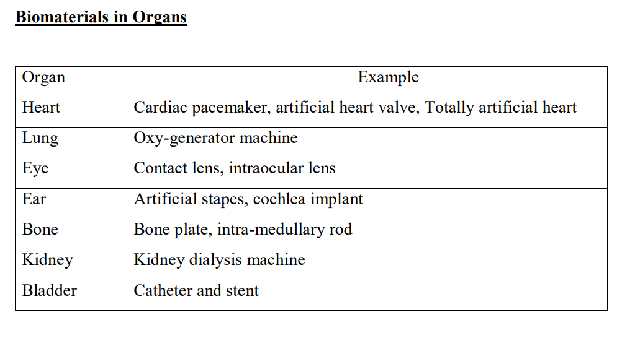
Biomaterials

Slide 13
Biocompatibility
From a biological point of view, biocompatibility is nothing but the acceptability of non-living materials (synthetic or natural) in a living body (mammal/human).
This acceptance is broadly defined as the “ability of a material to perform its desired functions with respect to a medical therapy, to induce an appropriate host response in a specific application and to interact with living systems without having any risk of injury, toxicity, or rejection by the immune system and undesirable or inappropriate local or systemic effects”.
Since a biomaterial is intended to be used in intimate contact with living tissues, it is important that the implanted material does not cause any undesired reactions to the surrounding tissues and host organs.

Slide 14
Apart from that, the implanted material is expected not to subdue the activity of normal cells or provoke any unwanted local or systemic reactions in the recipient, but is encouraged to generate positive cellular or tissue response.
Usually, the criteria for this biocompatibility are dynamic and detailed and differ with individual specific medical applications.
For example, a specially designed material (screw or plate) may possibly be biocompatible in bone implant surgery, but the same components may not be biocompatible in skin applications.

Slide 15
Factors affecting Biocompatiblity
WHAT AFFECTS A DEVICE/MATERIAL’S BIOCOMPATIBILITY?
There are three critical factors taken into account with biocompatibility testing:
The physical and chemical natures of a device’s material(s)
The human tissue that will be exposed to the material(s)
The length of the tissue’s exposure to the material(s)
Medical applications are not thought of as 100% biocompatible because the risk is never zero. It’s a question of how much risk is associated with a material. This is why some medical components are safe for short term use, rather than in long term.

Slide 16
Biocompatible
Components of biocompatibility
Following components are considered to constitute “biocompatibility”:
Beneficial tissue response and the clinically relevant performance
Cytotoxicity (Cell damage/death; systemic and local) – local toxicity is the adverse reactions emerging at the application site which is differentiated from systemic toxicity, in which adverse reaction appear in an area distant from the application site.
Genotoxicity-an alteration of the base-pair sequence of the genome DNA.
Mutagenicity-if theses genetic damages are passed on to the next generation, this effect is called mutagenicity.
Carcinogenicity-Carcinogenicity means that alterations in the DNA have caused a cell to grow and divide inappropriately; in other words, alterations of DNA promoted the generation of malignant tumors. Carcinogenicity results from several mutations. It is important to understand that not all mutagenic events lead to carcinogenesis.
Immunogenicity-the ability of a substance to provoke an immune response or the degree to which it provokes a response.

Slide 17
Biocompatible
WHY IS IT IMPORTANT TO USE BIOCOMPATIBLE MATERIALS?
The human body’s immune system is designed to protect it from external attacks, including germs such as viruses, parasites, bacteria, and fungi. This sort of response can occur when a healthcare application uses a non-biocompatible material.
The human body’s immense system is complex, so materials can produce a toxic response in the short term, long term, or when combined with other materials. For that reason, biocompatibility testing is critical for all classes of medical devices.
In many cases, a medical device will involve more than one material and several rounds of animal testing and clinical trials. The more complex a medical device, the more important testing is. Testing typically involves three types of tests:
Analytical chemistry
In vitro testing
Animal testing

Slide 18
Host response
Host response is defined as the “response of the host organism (local and systemic) to the implanted material or device”.
Most of the materials are never inert, and a biomaterial’s clinical success depends significantly on the host tissue’s reaction with the foreign material.
For material establishment- host tissue interaction, these reactions depend heavily on the timelength, purpose, and site of implantation.
Non-toxicity
Toxicity of biomaterials deals with elements that migrate out of the biomaterials. A carefully designed biomaterial should serve its purpose in the living body’s environment without negatively influencing other cells, organs, or the whole organism.
It is logical to assume that, unless specifically designed to do so, a biomaterial should not release or generate anything from its bulk.

Slide 19
Mechanical properties
In addition to biocompatibility, mechanical properties are embedded in biomaterial design prior to implementation and will majorly contribute to the outcome.
Materials undergo several forces which are primarily stress, strain, shear, and a mixture of these. The tensile strength, yield strength, elastic modulus, corrosion, creep, and hardness are some of the most important properties of biomaterials that should be carefully studied and evaluated before implantation. For hard tissue applications, the mechanical properties are of top priority.
Corrosion, wear, and fatigue properties
Wear is often considered as one of the leading causes of implant failure. In some cases, wear has also been shown to accelerate the corrosion of biomedical devices and implants. The fatigue resistance is related to the material’s reaction to repeated cyclic loads.

Slide 20
Design and manufacturability
Appropriate material design is also one of the critical factors to consider for biomaterials. For example, in the early 1900s, bone plates were utilized to assist in fixing long bone fractures.
Many of these experimental plates broke because of their primitive mechanical design where they were too narrow and had a stress-focusing corner.
Manufacturability is the ability to manufacture the item with relative ease that is ideal for its intended use at minimal cost and high reliability.
Concerning biomaterials, the manufacturability, in a broader sense, incorporates the potential of the material to be sterilized by a validated sterilization technique which is deemed appropriate for biomedical applications.

Slide 21
The material is expected to not get impaired by standard sterilizing techniques such as autoclaving, dry heat, radiation, ethylene oxide, etc.
In summary, for any material to qualify as a biomaterial, it should:
· Be biocompatible, i.e., non-toxic, non-carcinogenic, non-allergenic, etc.
· Have required/suitable physical and chemical properties
· Have suitable mechanical properties
· Have stable durability for the period it is intended for, i.e., hours to years
· Be easy to process with the available techniques
· Be sterilizable with current facilities without any difficulty
· Be cost-effective and accessible

Slide 22
CLASSIFICATION OF BIOMATERIALS
On the basis of Origin
Natural
On the basis of applications
Diagnostics (Gene array and biosensors)
On the basis of materials used
Metallic
Synthetic
Medical Equipment (Blood bags and surgical tools)
Therapeutic Medication (Medical implants and devices)
Emerging Regeneration materials (Tissue engineering skin and cartilage)
Skeletal system (joint replacement, bone fracture, tendons, ligands)
Cardiovascular system (blood vessels, heart valves)
Organs (Artificial heart, skin repair)
Polymers
Ceramics
Composites

Slide 23
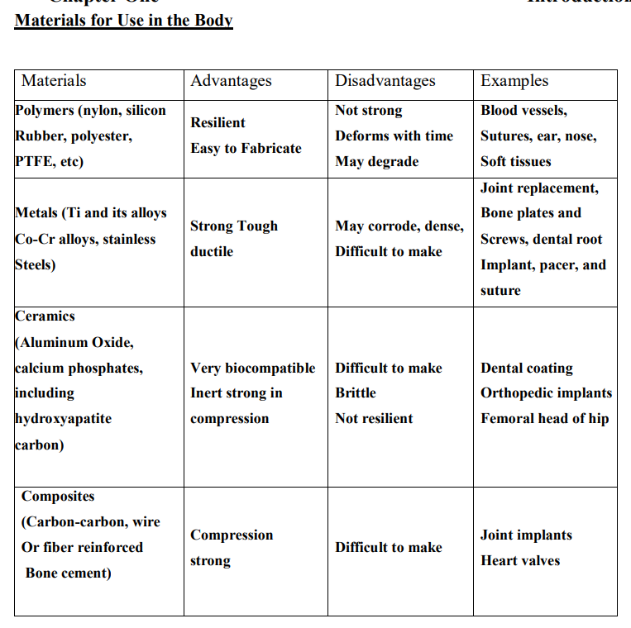
Biomaterials

Slide 24
Biocompatible Materials
BIOCOMPATIBLE MATERIALS
Alumina (a ceramic biomaterial)
Bioglass (ceramic biomaterial)
Cobalt-chromium alloy (metal)
Hydroxyapatite (ceramic biomaterial)
Medical-grade silicone (short-term implantable and long-term implantable)
Polyvinylchloride (PVC) (polymer)
Polyethylene (PE) (polymer)
Polypropylene (PP) (polymer)
Polytetrafluoroethylene (PTFE) (polymer)
Polymethylmethacrylate (PMMA) (polymer)
Stainless steel
Trimethylcarbonate (polymer)
TMC NAD-lactide (polymer)
Titanium & titanium alloys (metal)
Zirconia (ceramic biomaterial)

Slide 25
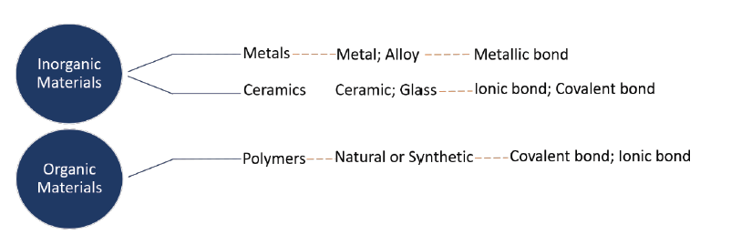
On the basis of materials used
Depending on the chemical bonding, materials can be categorized into three broad groups. These are (i) polymers, (ii) ceramics, and (iii) metals.
Because these material structures vary by their nature of bonding (covalent, ionic or metallic), they have different properties, and hence different uses in the different kinds of biomaterials and chemical bonds associated with it
Metals and ceramics are differentiated in the field of materials engineering, although they are both inorganic compounds. Each material has its own benefits and drawbacks, and its biomedical applications are decided according to its individual properties and intended place substitution

Slide 26
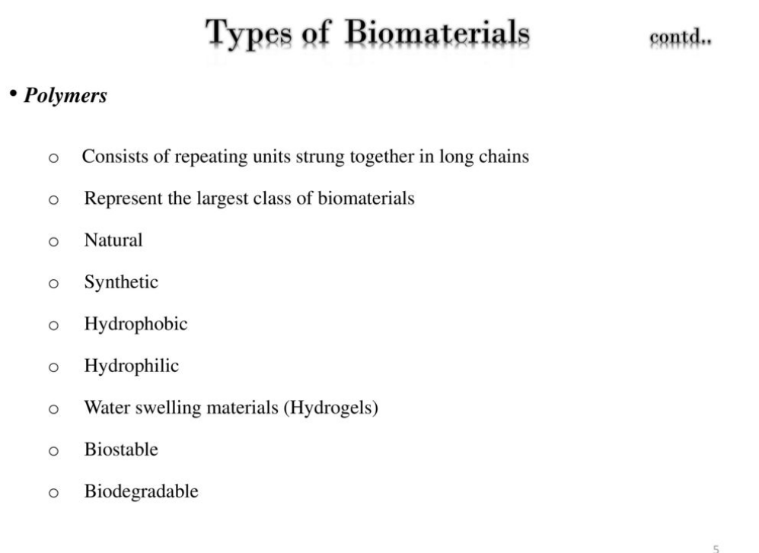
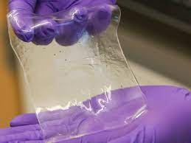
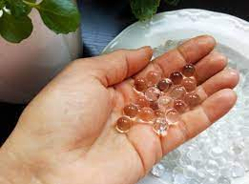
On the basis of materials used
Polymers
Largest class of Biomaterials
Hydrogels

Slide 27
Advantages
Widely applied in biomedical applications due to their
low toxicity in biological fluids
easy pre/post-processing
easy sterilization
better shelf life
lightweight nature
Remarkable physical and chemical properties.

Slide 28
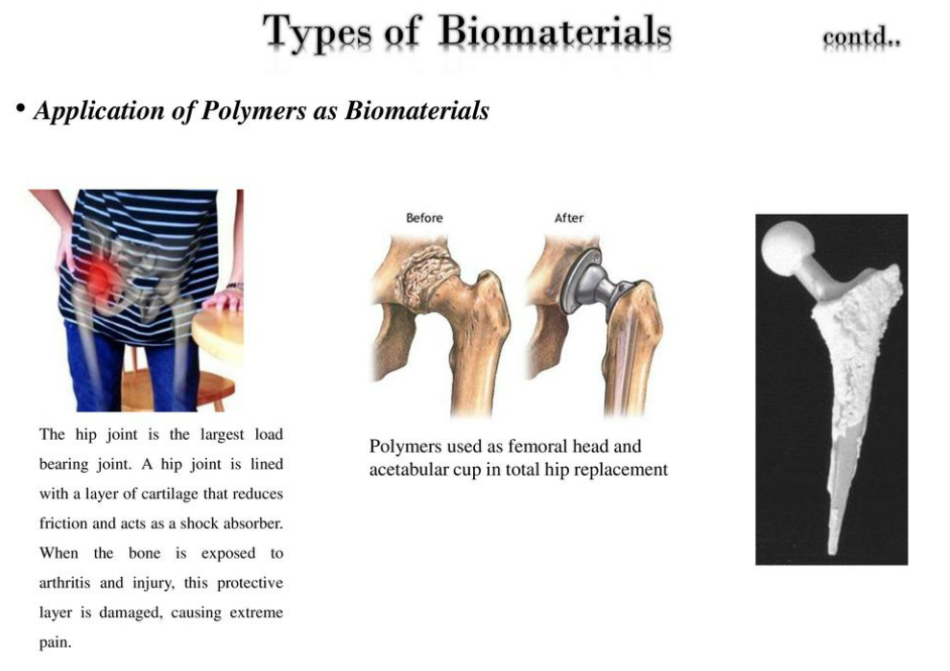
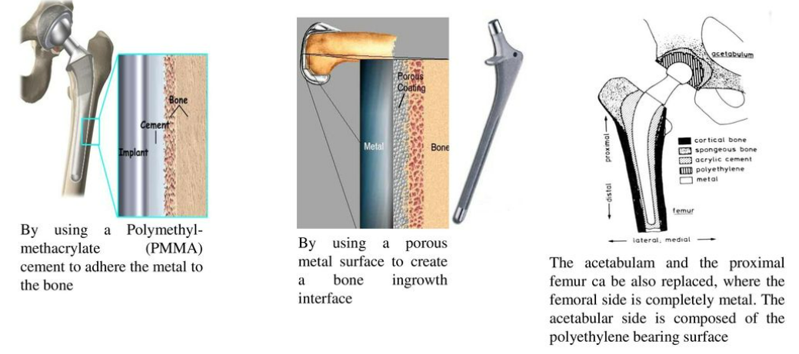
Applications

Slide 29
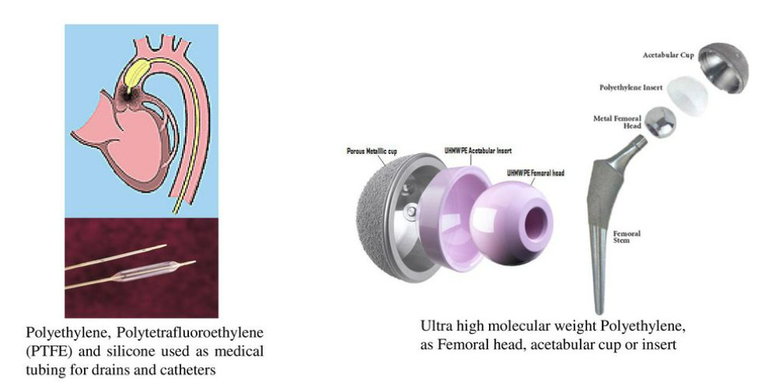
Applications

Slide 30
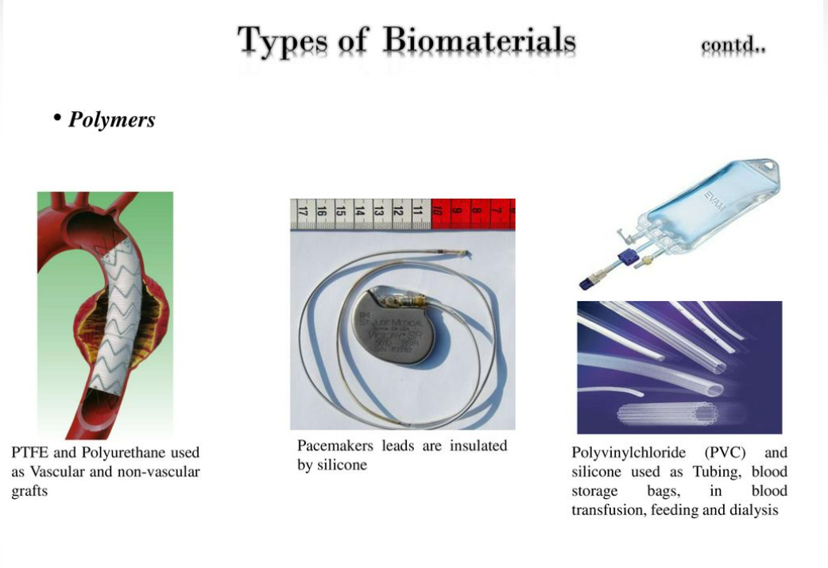
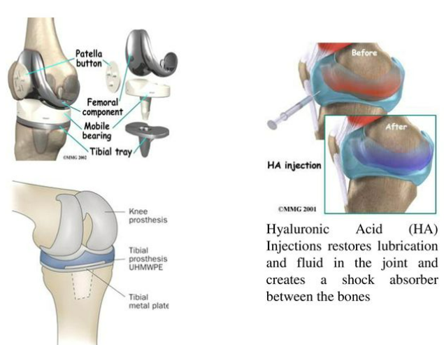
Applications

Slide 31
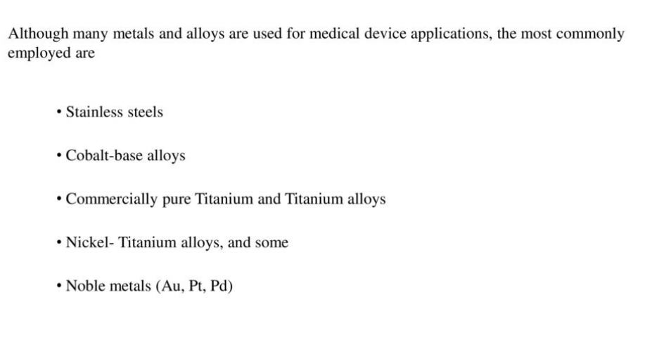
On the basis of materials used
Metals
Most widely used class of Biomaterials

Slide 32
1. Mostly crystalline 2. high tensile strength 3. Resistance to fracture toughness 4. better elasticity 5. better rigidity 6. outstanding mechanical reliability
Metals
Properties

Slide 33
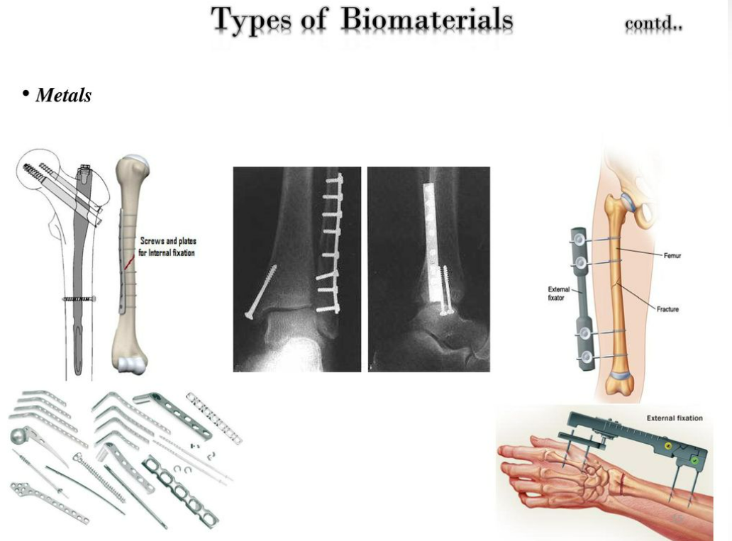
1. Load bearing implants like orthopaedic, dental and maxillofacial surgery 2. Stent and stent graft in cardiovascular surgeries 3. Screws and plates for external fixation
Metals
Applications

Slide 34
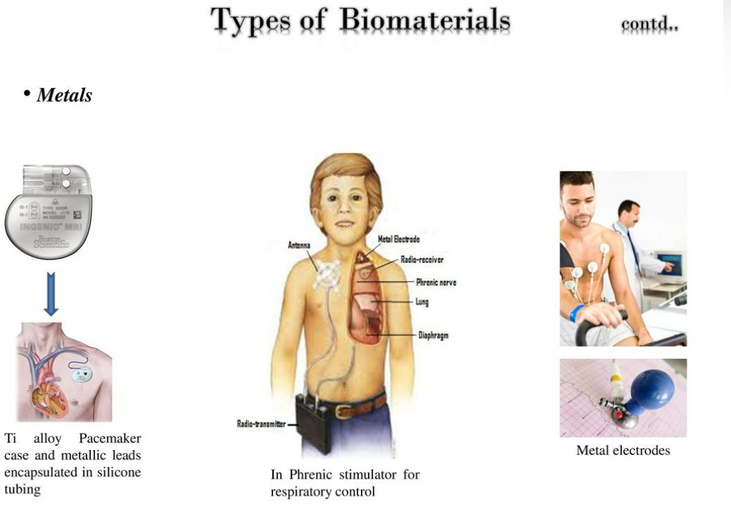
4. Ti-Alloy pacemaker case and metallic leads encapsulated in silicone tubing 5. In phrenic stimulator for respiratory control 6. Metal electrodes
Metals
Applications

Slide 35
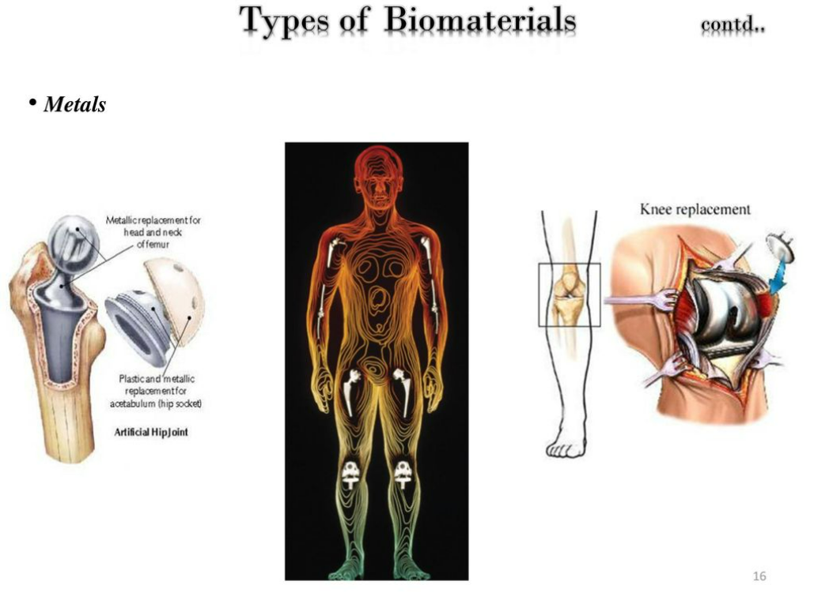
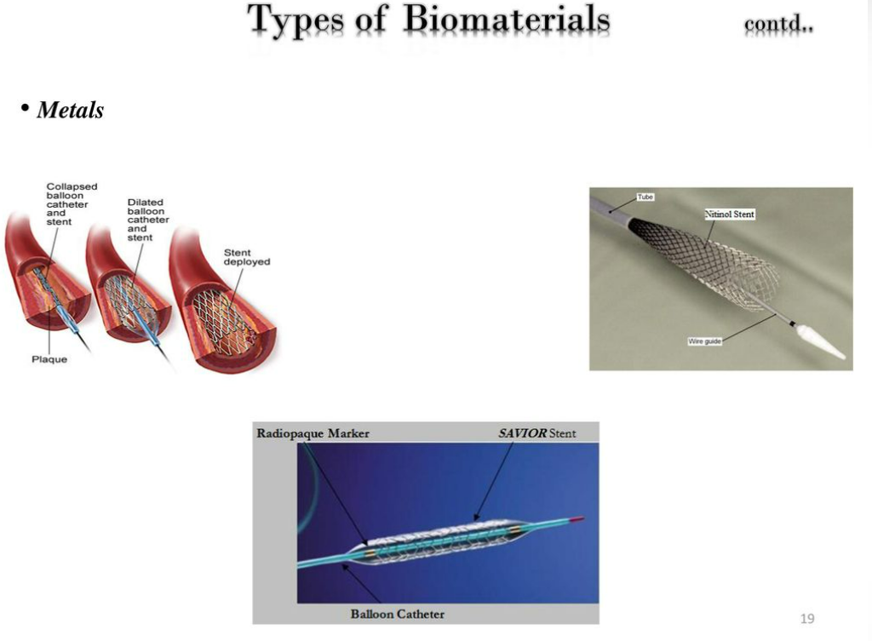
7. Head and neck of femur replacement 8. Knee replacement 9. Stent
Metals
Applications

Slide 36
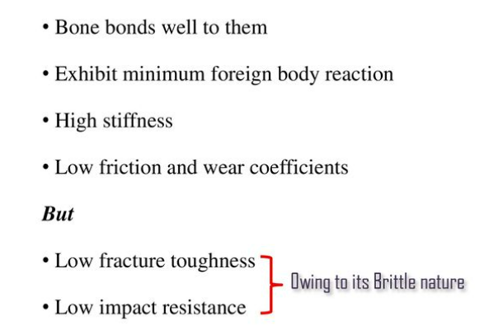
On the basis of materials used
Ceramics
Inorganic solid materials made up of metallic and non metallic elements bound together via ionic bonds
May be crystalline or amorphous

Slide 37
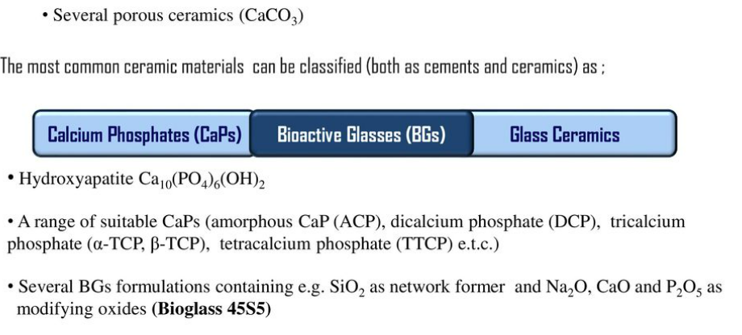
Further classified into
1. Bioinert ceramics:
Alumina Al₂O₃
Zirconia ZrO₂
2. Bioresorbable
Ceramics
Types

Slide 38
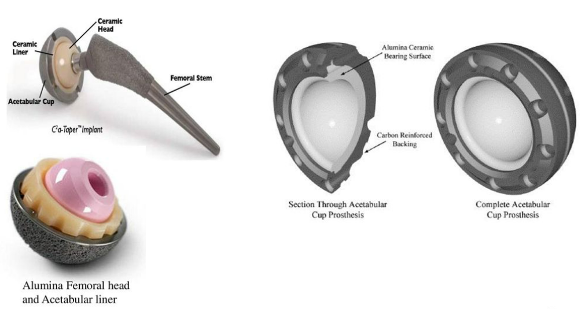
1. Femoral implants
Ceramics
Applications

Slide 39
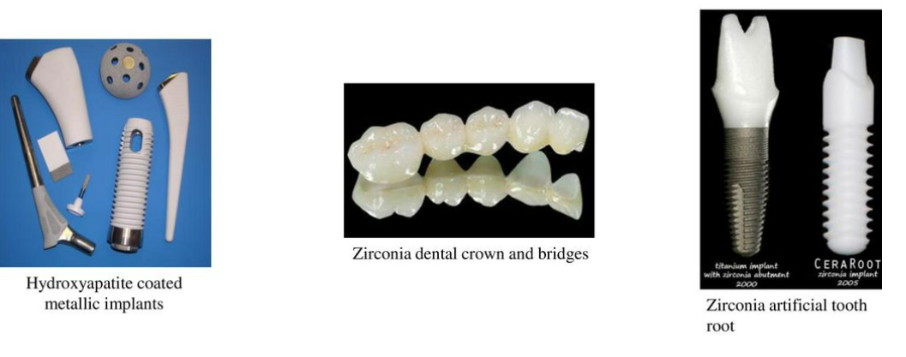
2. Cosmo-surgery/orthodontics
Ceramics
Applications

Slide 40
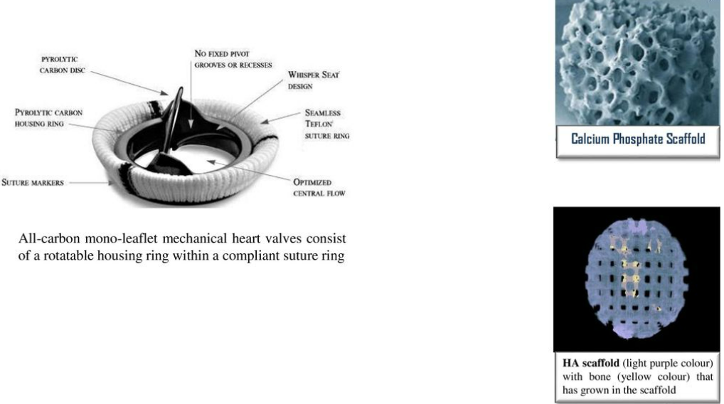
2. Cardiac-surgery
Ceramics
Applications

Slide 41
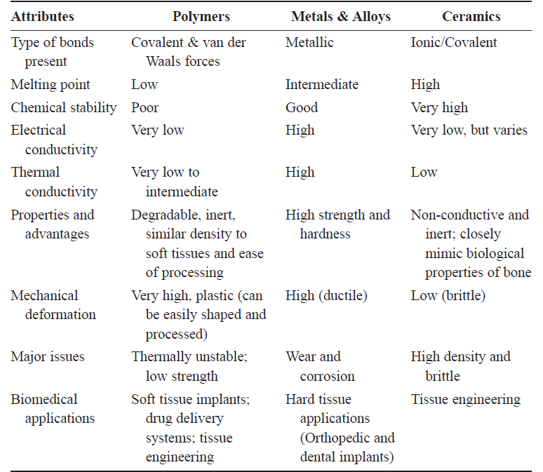
Comparison of typical properties of biomaterials

Slide 42
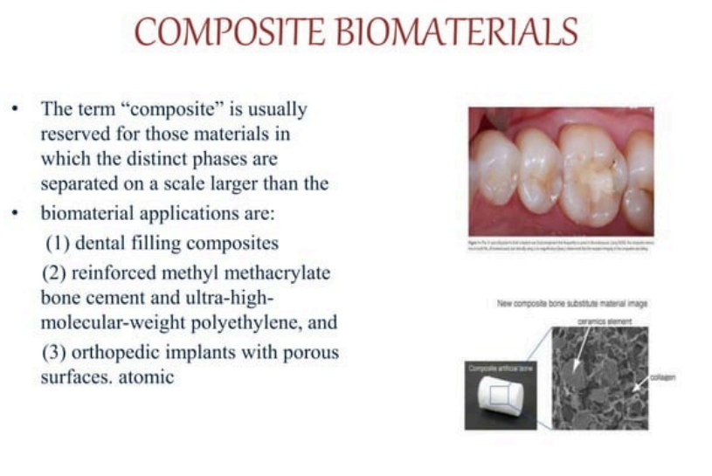

Slide 43
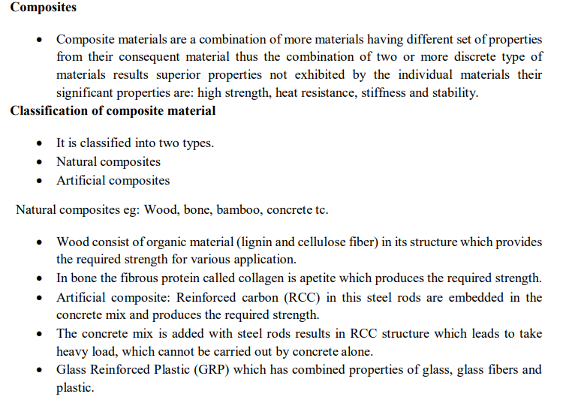

Slide 44
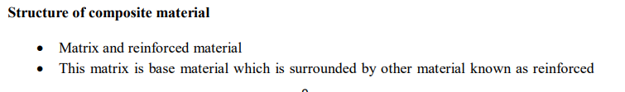
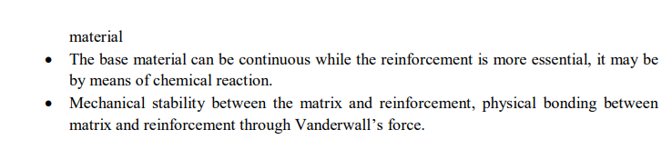

Slide 45
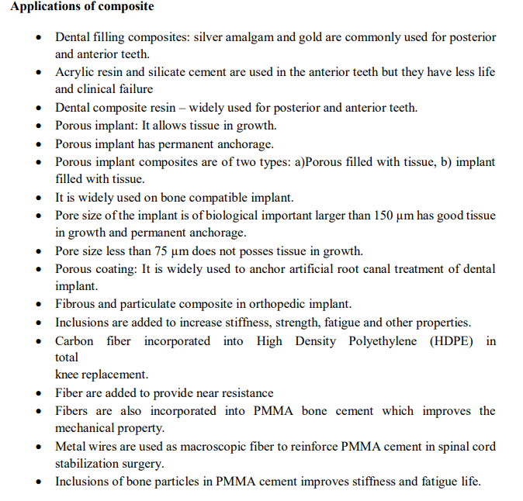

Slide 46
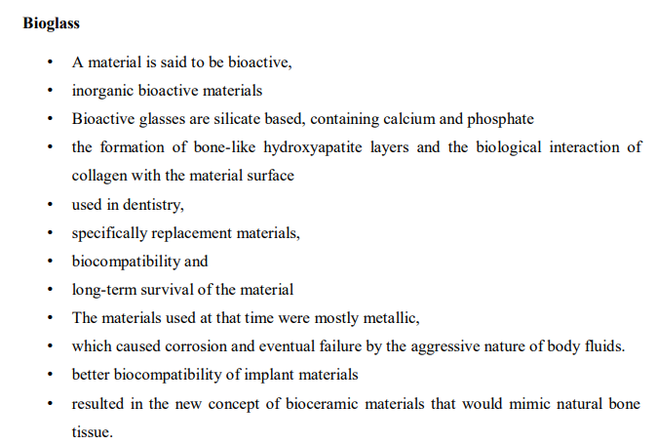
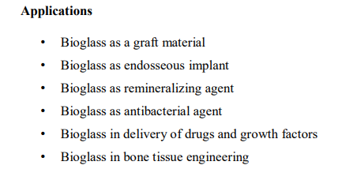

Slide 47
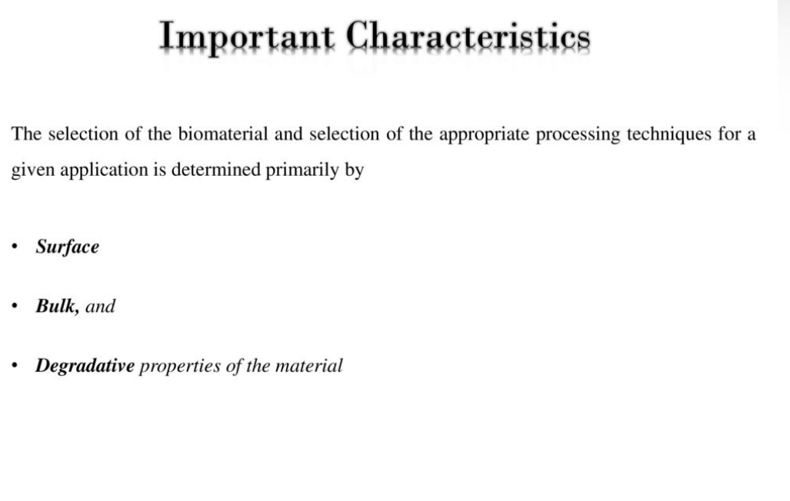
Biomaterials

Slide 48
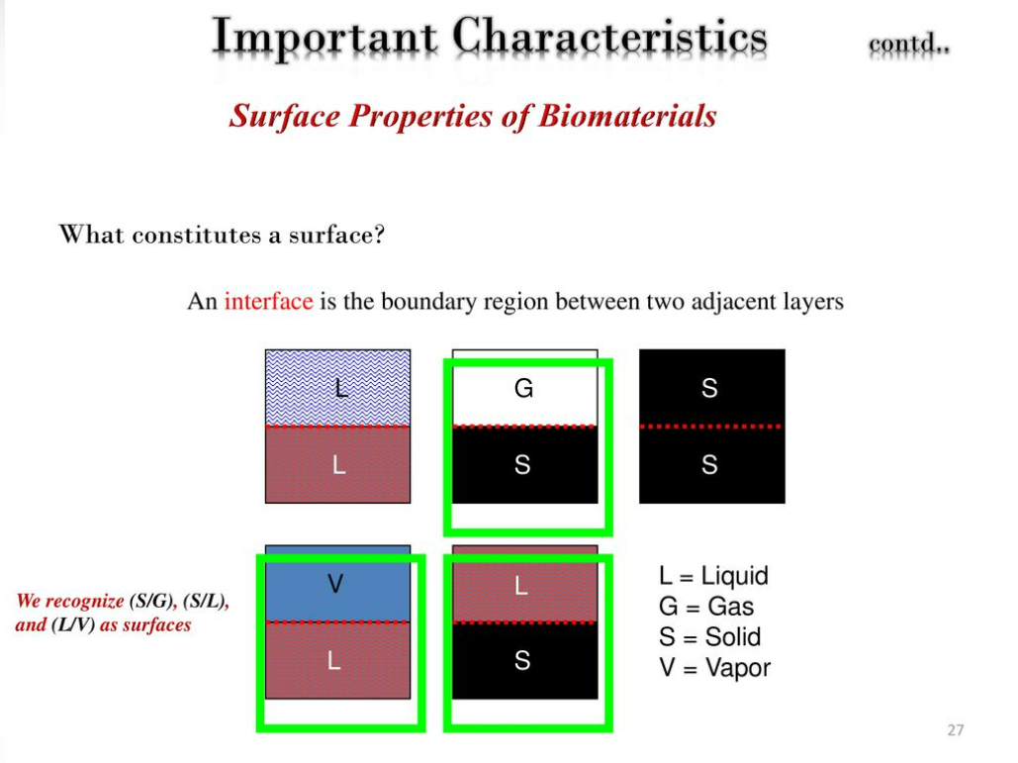
Biomaterials

Slide 49
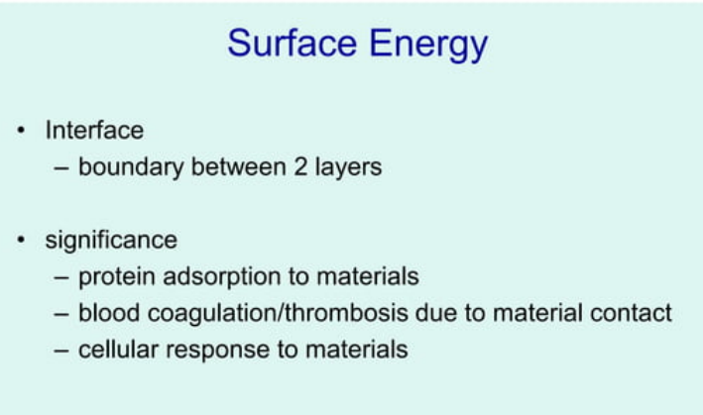
Biomaterials

Slide 50

Biomaterials

Slide 51
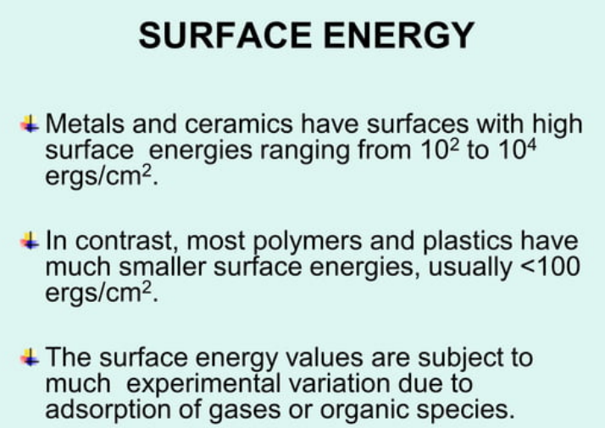
Biomaterials

Slide 52
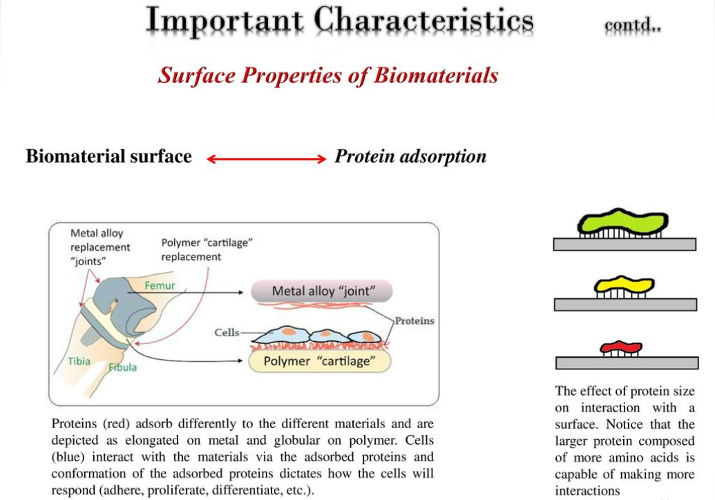
Biomaterials

Slide 53
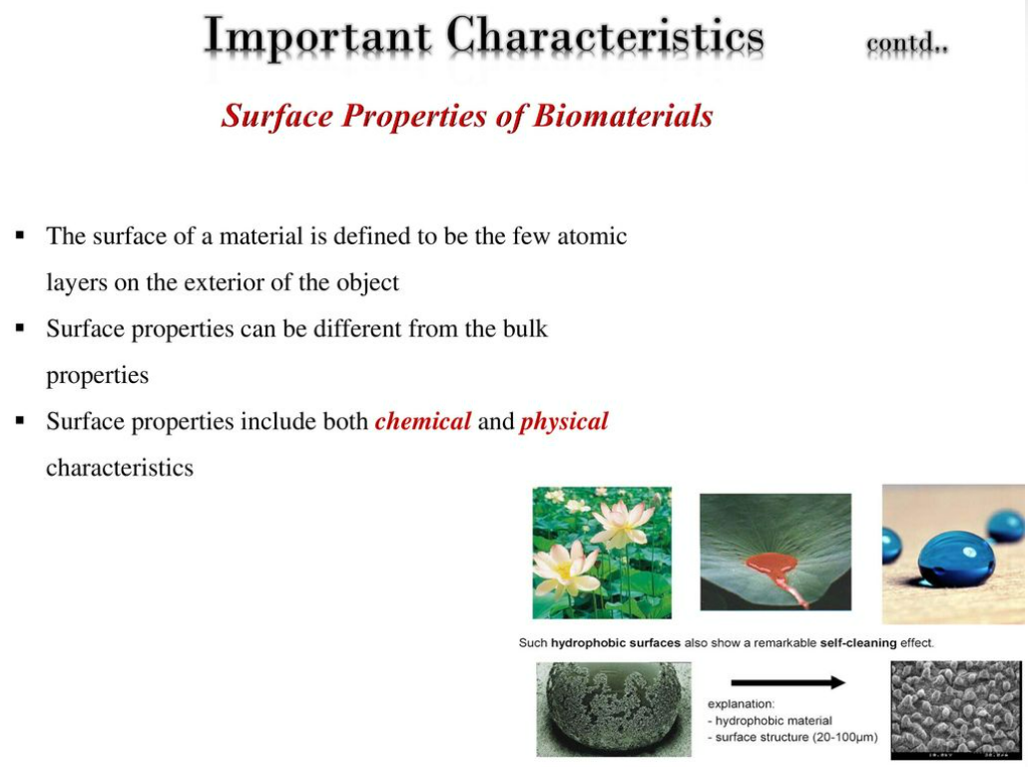
Biomaterials

Slide 54
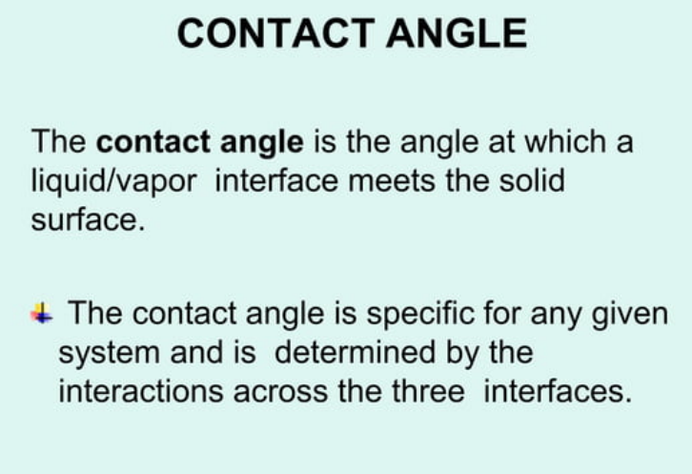

Slide 55
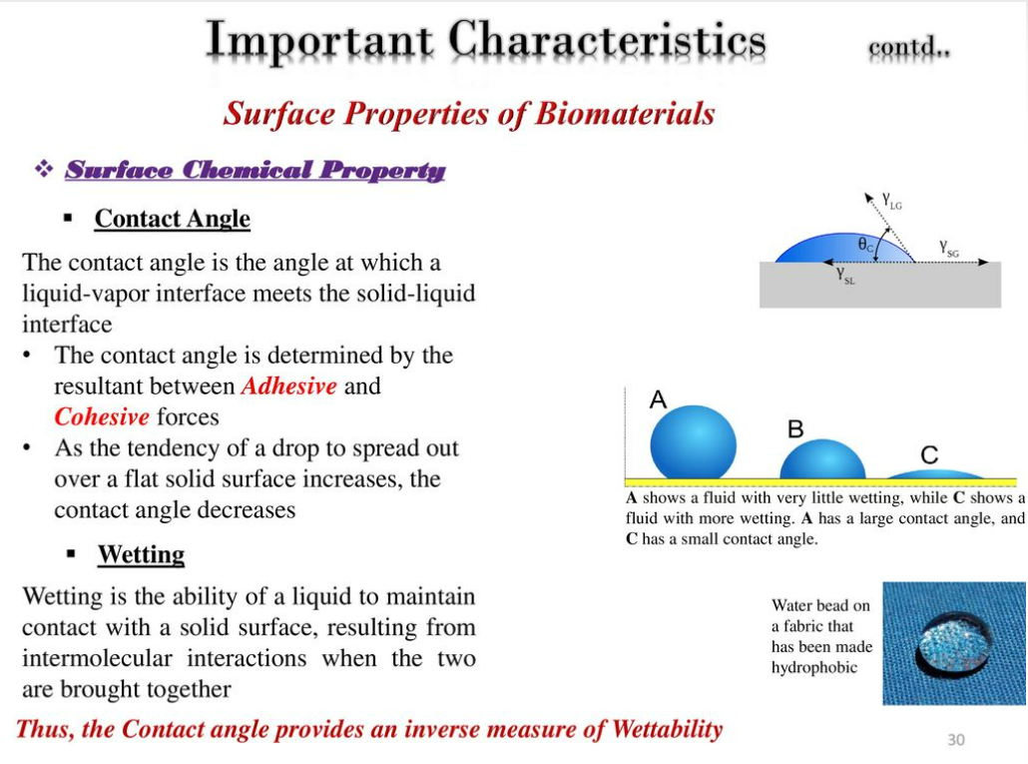
Biomaterials

Slide 56
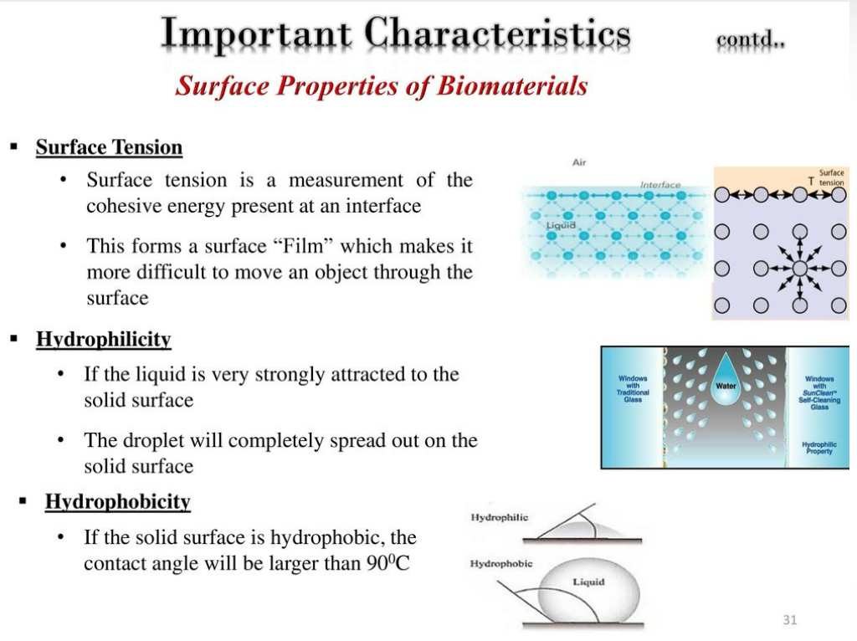
Biomaterials

Slide 57
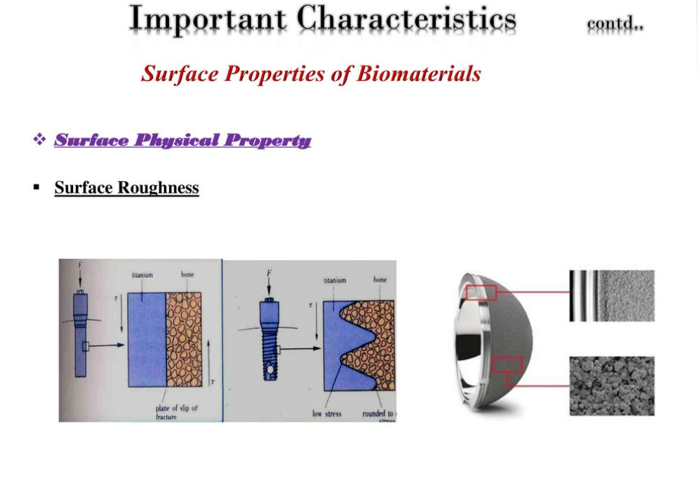
Biomaterials

Slide 58
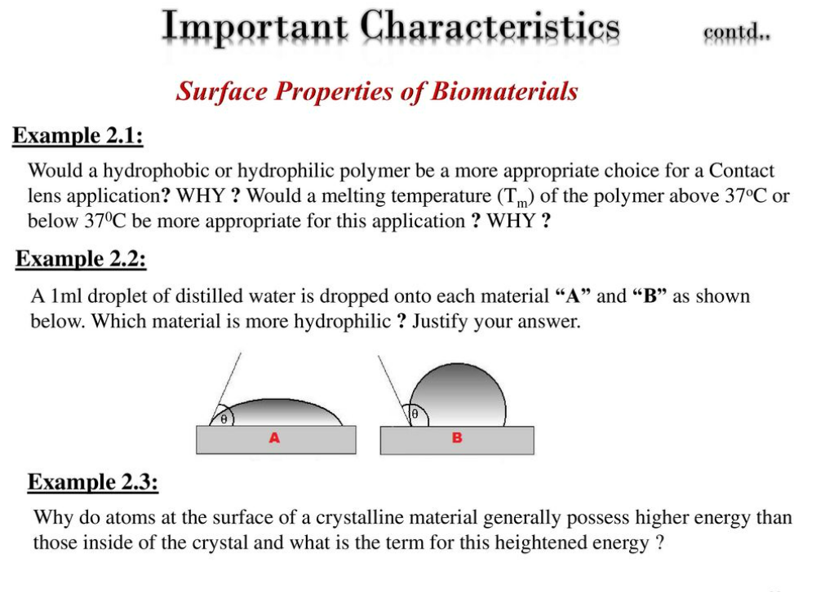
Biomaterials

Slide 59
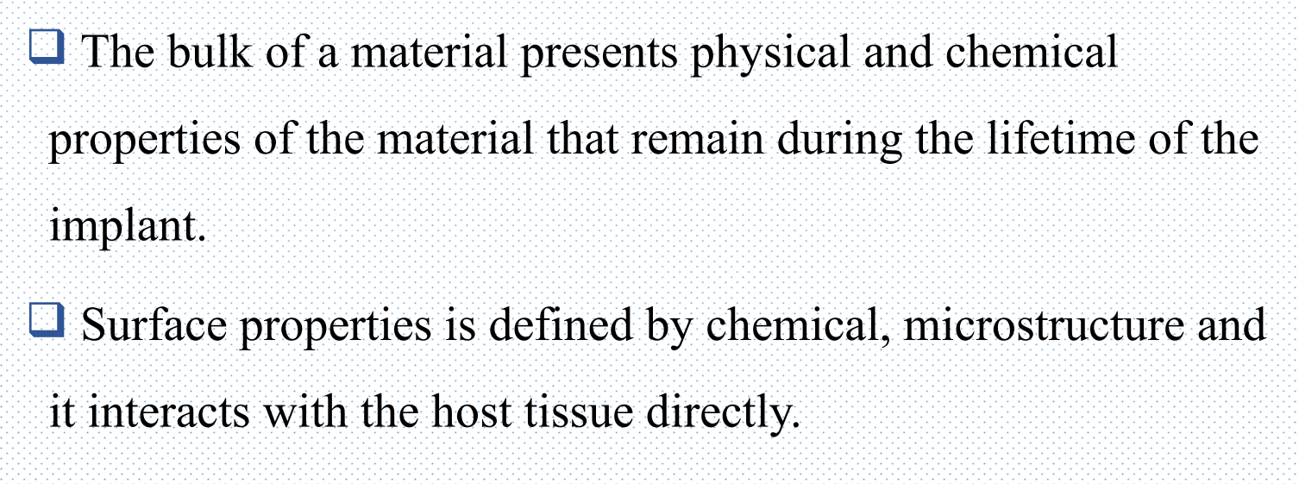
Bulk Properties

Slide 60
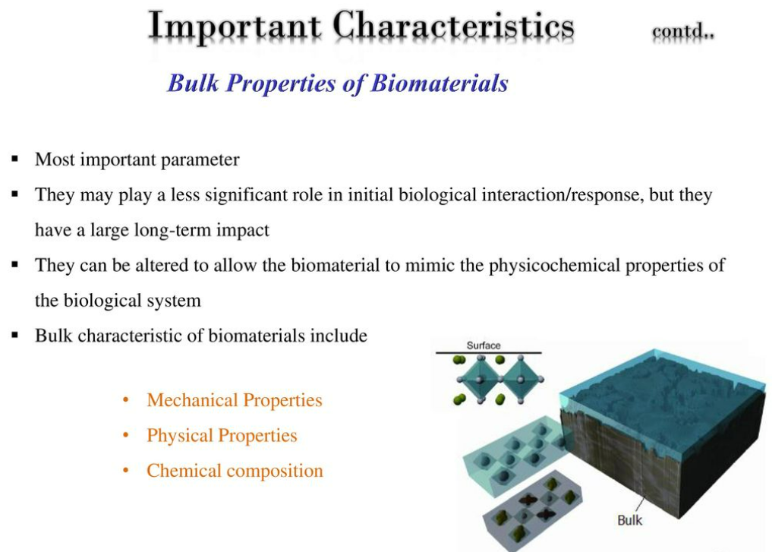
Biomaterials

Slide 61
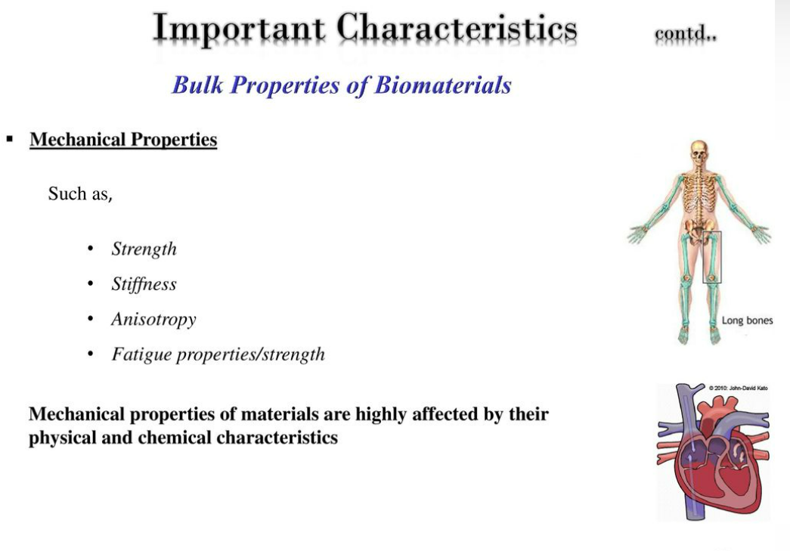
Biomaterials

Slide 62
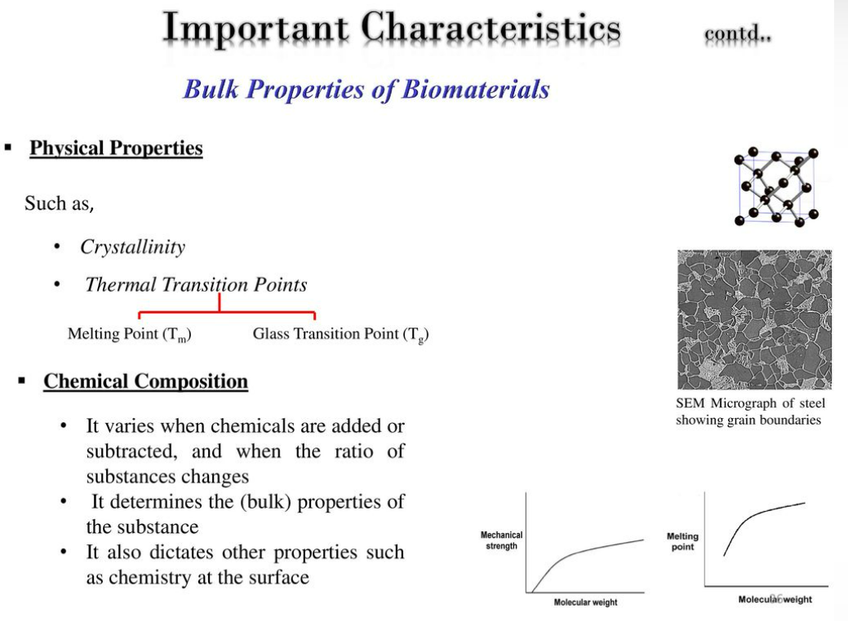
Biomaterials

Slide 63
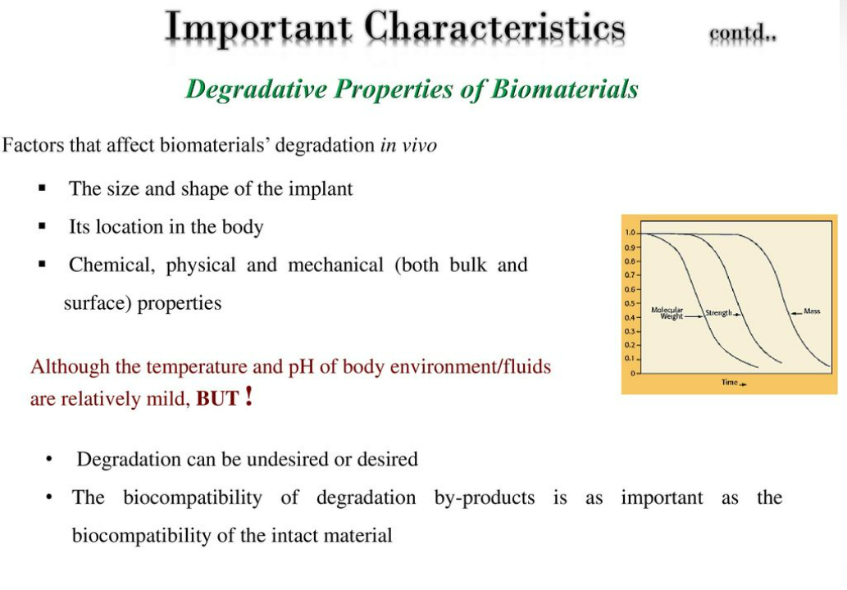
Biomaterials

Slide 64

Diamond like carbon films

Slide 65

Diamond like carbon films

Slide 66

Diamond like carbon films

Slide 67

Diamond like carbon films

Slide 68

Diamond like carbon films

Slide 69

Diamond like carbon films

Slide 70

Biomaterials

